Slide 1
Vision, Mission and Goal Setting
Duran Inci CEO duran@optimum7.com www.duraninci.com

Slide 2
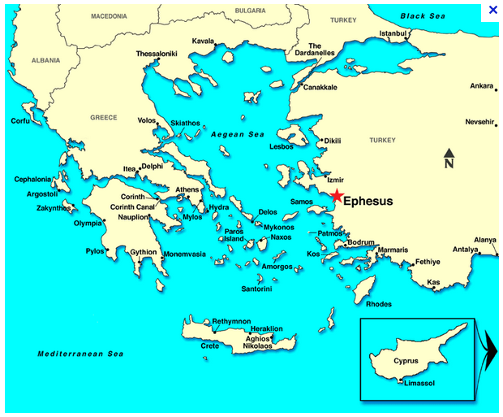
I’m from Izmir / Smyrna / Ephesus
6,000 BC
250,000 population in 100 BC
Largest city in the Mediterranean

Slide 3
Where’s the Grave of Virgin Mary?
Only a few Christians know…
Visions of Katharina Emmerich

Slide 4
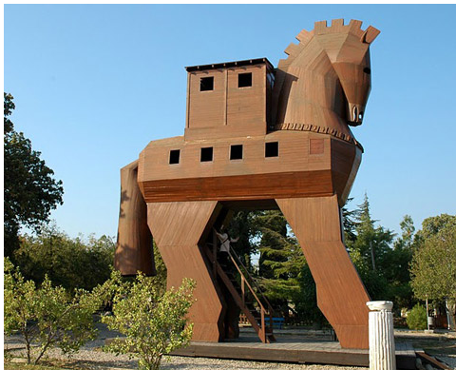
Where’s Troy?
Almost nobody knows…
Notes:
You know the story the Trojan War. The war between Greeks and Trojans where the Greeks could not pass the high city walls of the Trojans and they build a wooden horse to make it seem like an offering to Poseidon. The horse was basically a tool they used to capture the city of Troy. It was innovation and it was creative.

Slide 5
Notes:
Today we try to win the minds and the hearts of others via persuasion. Everything starts with an idea… It does not matter what race you are, where you live, what gender you are or what profession you are in... You guys decided to study law, build law practices and then be a part of this organization.
But, what is the Miami Dade Bar Association for? What is the primary purpose? What is the value proposition that you offer? The significance? How how do you enforce that value and significance? Make it accountable? Responsible?

Slide 6
Notes:
Details matter… Are you wearing a hat or not? The hat might mean everything, or nothing. What is your hat? What does it represent?
The hat in this example represents a core change, so unique that it changes the entire perspective. What is your core value? The element that is deep within yourself and your organization?

Slide 7
Notes:
Speaking of core values, most of you have probably seen this. This photo is called the “Flower power”. Bernie Boston took this photo in 1967 during the Vietnam War. This unique action was the movement against war. And capturing this move so vividly allowed this movement to spread. So, something as small as a single photograph can affect the masses. Identifying the core values of your organization and movement can make all the difference. But doing this not as a task, but owning this! How better can you own an idea than stand in front of loaded rifles holding nothing but a flower?

Slide 8
Notes:
So, a mission and a vision statement that you all believe in and agree with, can make a difference in the future of your organization. “Optimum7 is an indispensible resource for organizations, mainly ecommerce and b2b businesses, as a provider of custom technology solutions, software and digital marketing.” Indispensible resource… That is my key offer and point. Requires ownership and accountability, and no BS.

Slide 9
Notes:
My vision statement is the following; “Optimum7 aims to be an industry software leader in E-commerce Automation, AI and Machine learning with over 20 tools in the market serving over 50,000 businesses. With a team of 100 employees at 5 locations worldwide, Optimum7 creates software solutions that solve real life problems, enhances businesses, makes our partners more efficient, and elevates people and our community with technology.“ Vision is a bit more complex, must take the future into consideration. It cannot be a generic statement.
Speak about Crisp video. “To increase the average retainer of my clients”, not a video guy. Brand positioning.

Slide 10
Notes:
Mission and Vision can take your organization where it needs to go.

Slide 11
DCBA Mission and Goals Our Mission
The Dade County Bar Association’s mission is to be the voice of Miami-Dade County’s legal profession, serving the public and the bar by promoting equal justice, professionalism and civility, and excellence and respect for the law.
Goals
The goals of the DCBA are as follows:
To serve the needs of our membership.
To advocate for improvements to the justice system.
To provide leadership for the legal profession and the community.
To raise and maintain the ethical and professional standards of conduct of the bar.
To educate the public about the justice system and the legal profession.
To preserve the independence of the judiciary.
To promote meaningful access to justice for all people, of any economic or social condition.
To promote diversity within the legal profession.
To promote responsibility for public service by lawyers.
To build and maintain a strong financial and organizational infrastructure to carry out the goals of the Association.
Notes:
So, is this still accurate and relevant? Benefits for members? Why should somebody sign up? What is the true value? Benefit for courts? For the community? What kind of a brand power does your organization have?

Slide 12
Notes:
Speaking of brands; a powerful brand is not only created with money. You do not have to be an Intel or Coca Cola. Creativity and innovation creates brands all the time. This is a prime example;

Slide 13
Notes:
So, how are you differentiating yourself from everybody else? If there are thousands of lawyers and bar associations, how is this organization different?

Slide 14
Technology
Spyfu.com allows you to see competitors traffic, leads and data.
Crystalknows.com allows you to see personality profiles of almost anybody.
Pipl.com allows you to acquire the contact information of almost anybody.
Lyrebird.ai allows you to mimic anybody’s voice and create targeted messages from your own voice.
Postlead.io allows you to personalize direct mail to your clients.
Sitecompliance.com allows you to check your competitor’s and client sites for ADA Compliance.
Notes:
And thousands of more tools.

Slide 15
Notes:
So, if you are not marketing, innovating and thinking different, you will become obsolete.

Slide 16
Notes:
AI is going to take over the world! Ellon Musk is estimating that 75% of the labor force will disappear and will not be needed. The yare working on a system of government where this 75% can be paid a monthly salary just to exist. Because they will not find jobs. Super artificial intelligence will follow. If this sounds like Sci-fi, that is because it is sCI-FI. Remember the dvices they used to talk to each other, get directions and heal people in the 60sin Star trek?

Slide 17
Notes:
Botkeeper is a tool for bookkeeping and accounting that uses machine learning. The CEO is a good friend of mine.

Slide 18
Notes:
This is a current AI tool that analyzes data. Case data, workflows to handle cases, precedence optimization and application. I can get access to this tomorrow.

Slide 19
Notes:
So we started this presentation talking about creating an idea. imagination is the pre-requisite for an idea before it can blossom. And any successful business or product is 10% idea and 90% execution.

Slide 20
Notes:
What is your E = MC2? What is the world changing, world altering idea that you have? How can it or how does it relate to LAW and serving the community? We all must have one, or a few.

Slide 21
Notes:
So, what is your true value proposition as an organization?
Not brute force but only persuasion and faith are the kings of this world. As the Trojans did, but more kindly, how will you get in the minds and castles of others? Thomas Carlyle

Slide 22
Notes:
No matter how serious we might think our jobs are, we cannot lose touch with human emotion, appealing to human emotion and understanding the need for the simple elements of life; such as freedom, access to information and education and more....
And to be able to care about the nice things in life, in today’s economic environment, we need resources… (next slide)

Slide 23
Notes:
We need money! This is a cycle… An organization that has so many responsibilities MUST survive and thrive.

Slide 24
Notes:
How closely are we paying attention to the revenue of the organization? - Member dues - Leveraging the Building, what is the plan? Are you renting, renovating, selling? What is the goal?

Slide 25
Notes:
How are you budgeting and planning? We cannot ever afford to get complacent in today’s fast paced and competitive economy.

Slide 26
Notes:
Responsibility is a tricky word. We simply MUST be able to do what we must do! Responsibility and Fault.

Slide 27
THANK YOU
Duran Inci CEO duran@optimum7.com www.duraninci.com
27
of
27

